Slide 1
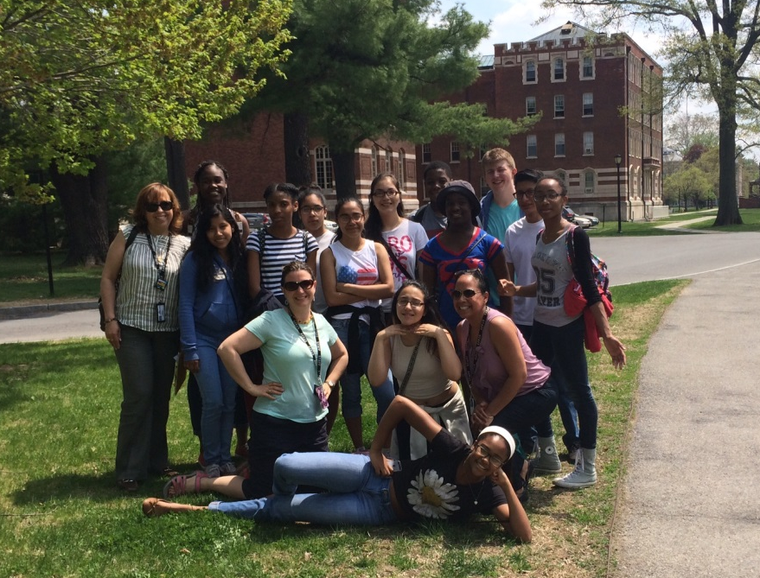
Superintendent’s Report
Dr. David Fine
Meeting of the Board of Education
July 7, 2015

Slide 2
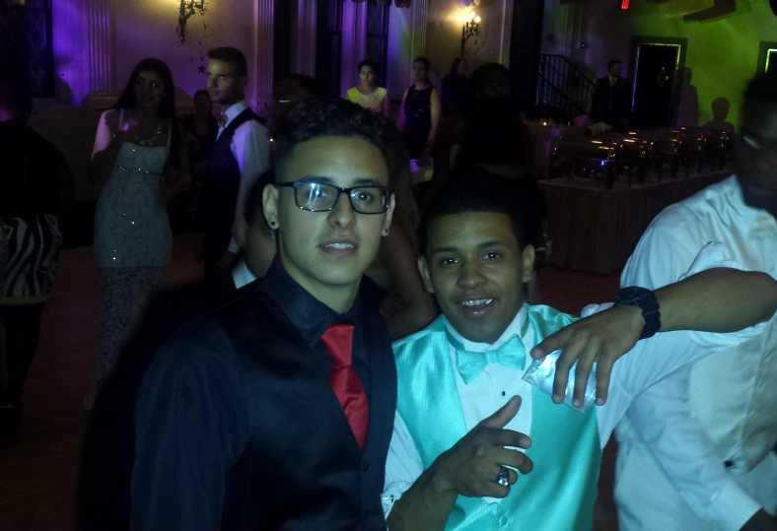
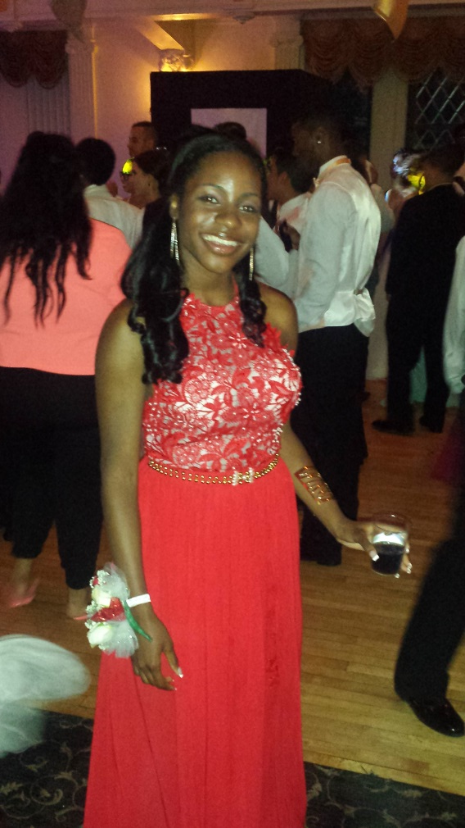
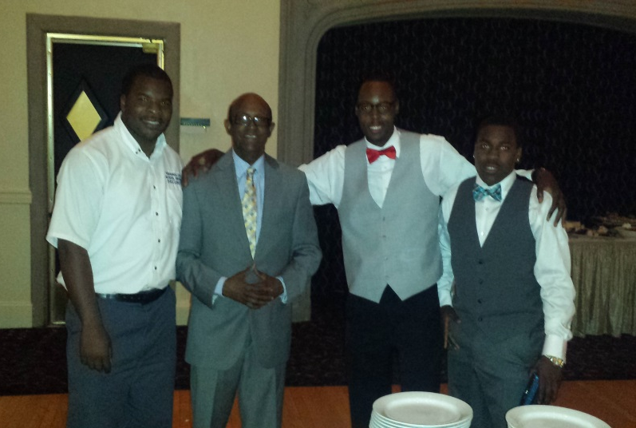
Peekskill High School: Senior Prom

Slide 3
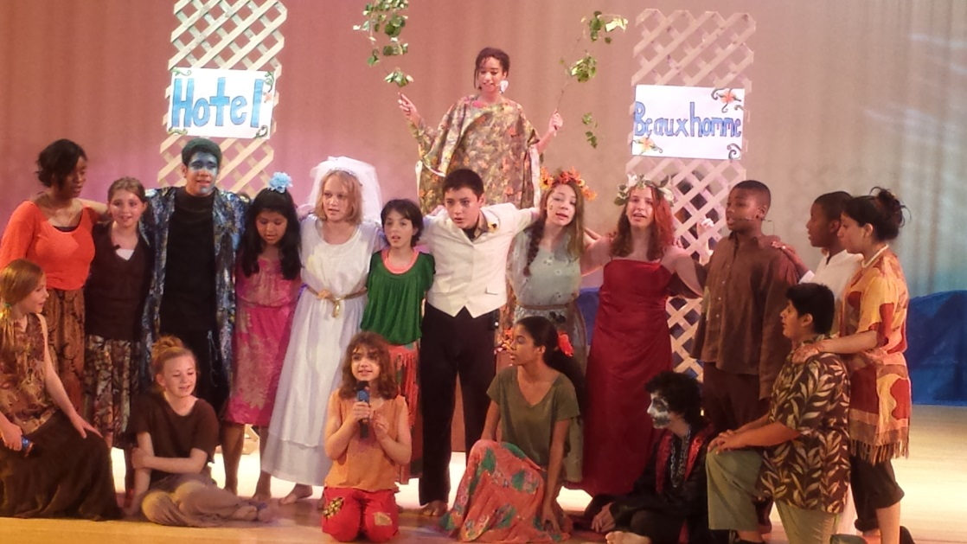
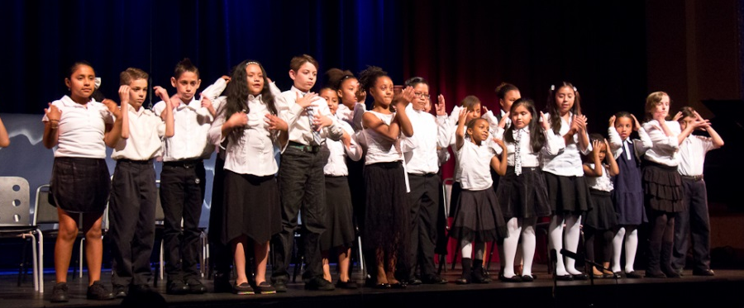
Middle School Play and Kiley Performance (Hillcrest Community School)

Slide 4
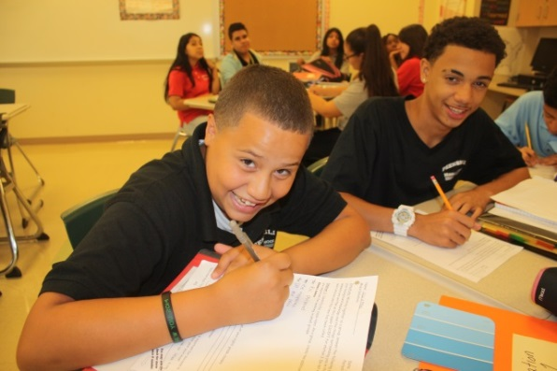
Top Ten (10): Reasons Peekskill is a Wonderful Place to Live and Learn
10. Riverviews and Waterfront
9. Amazing Music, Art, and Food
8. Rich History
7. 21st Century State of the Art Middle School
6. Dedicated Staff, Administration, and Faculty
5. Appreciative and Hard Working Student Body
4. Passionate and Focused Board of Education
3. Talented Performing Arts Program
2. Targeted Academic Courses and
Dedication to CIA Alignment
1. We Send Children to Harvard

Slide 5
Operation Recognition: Mr. John Lancaster
Peekskill High School’s Graduating Class of 1943
USA Navy, enlisted 2/20/43
  American Theater Medal
  European Theater Medal
  Victory Medal
St. Peter’s Episcopal Church Altar (70 years)
Honor to Recognize deserved diploma and years of service to country (section 305 NYS Ed. Law)

Slide 6
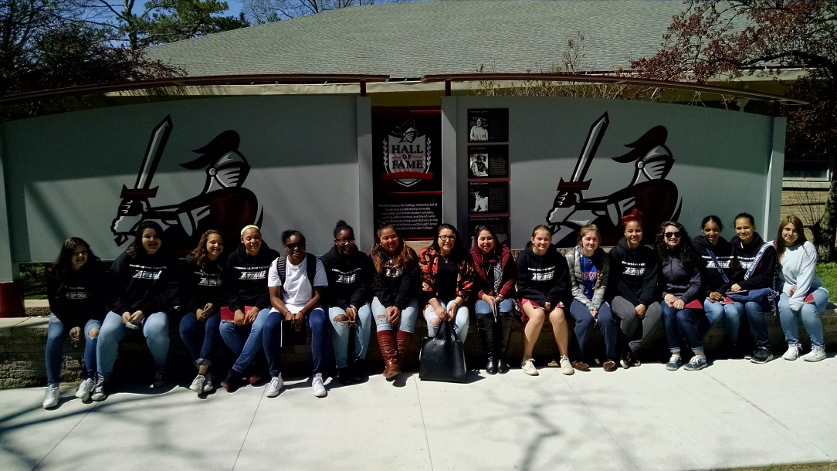
Thank You and Enjoy the Evening
*This Concludes the Superintendent’s Report
--Be Good to Yourself and Each Other--
“Be the Change you wish to see in the World.”
M. Ghandi

